Slide 1
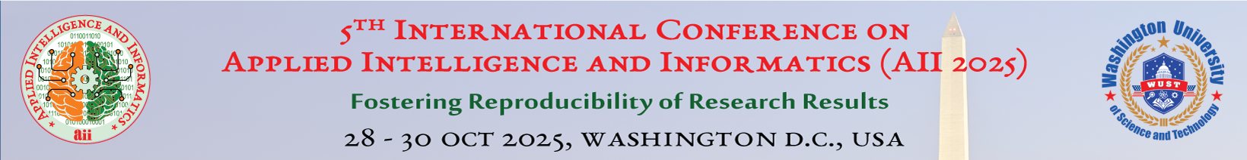






Contrastive Self-Supervised Learning Framework for
Multi-Class Alzheimer’s Disease Diagnosis from MRI Images
Paper ID- 2025051097
${Francis Rudra D Cruze}^{a,b}$, ${\text{S}\text{. }\text{M}\text{. }\text{Hasan} \text{Mahmud}}^{ b,c,∗}$, ${\text{Md}\text{. }\text{Faruk} \text{Hosen}}^{a,b}$
rudra16-563@diu.edu.bd, drhasan.swe@diu.edu.bd, faruk.cis@diu.edu.bd
$${Department of Computing and Information System, Daffodil International University (DIU), Ashulia, Dhaka, Bangladesh}^{a}$$
$${Center for Advanced Machine Learning and Applications (CAMLAs), Bashundhara R/A, Dhaka 1229, Bangladesh}^{b}$$
$${Department of Software Engineering, Daffodil International University \left(DIU\right),Ashulia, Dhaka, Bangladesh}^{c}$$

Slide 2

5th International Conference on Applied Intelligence and Informatics (AII 2025)
Outline
Introduction
Problem Statement
Related Work
Research Question
Objective
Impact & Outcome
Methodology
Result
Conclusion
Future Work
References
Paper ID- 2025051097
2

Slide 3
5th International Conference on Applied Intelligence and Informatics (AII 2025)
Introduction
Alzheimer’s Disease (AD) is a progressive neurodegenerative disorder and the most common cause of dementia worldwide.
The prevalence of dementia is expected to nearly triple by 2050, posing significant social and economic burdens.
Early diagnosis is crucial as AD pathology begins decades before clinical symptoms appear, but it remains a major challenge.
Neuroimaging techniques like Magnetic Resonance Imaging (MRI) are vital for visualizing structural brain changes associated with AD.
Deep Learning shows promise in analyzing medical images but often requires vast amounts of labeled data, which is scarce and expensive to obtain in medical domain.
Paper ID- 2025051097
3

Slide 4
5th International Conference on Applied Intelligence and Informatics (AII 2025)
Problem Statement
The successful application of deep learning for Alzheimer’s diagnosis is severely hindered by its reliance on large, annotated datasets, which presents three critical challenges in a clinical context:
  The Annotation Bottleneck: Manually labeling thousands of MRI scans requires significant time and cost from clinical experts. This process is not only a major bottleneck but can also introduce bias and inconsistencies, limiting the scale and quality of training data.
  Poor Generalization to Real-World Data: Models trained on limited, homogenous datasets often fail to generalize to the diverse range of patients, imaging protocols, and equipment found in different hospitals. This “generalization gap” makes them unreliable for widespread clinical use.
  Failure to Recognize Rare Disease Stages: Standard supervised models struggle with severe class imbalance. For instance, in our dataset, the “Moderate Dementia” class is extremely rare (0.5%), leading to models that are poorly trained to identify less common but critical stages of the disease.
Paper ID- 2025051097
4

Slide 5
5th International Conference on Applied Intelligence and Informatics (AII 2025)
Related Work
Our research builds on a foundation of supervised and self-supervised methods for AD diagnosis:
Supervised Deep Learning:
  Murugan et al. (2021): Developed “Dem-Net,” a supervised deep learning model that achieved high accuracy (95.23%) for AD diagnosis from MRI scans [1].
  Fan et al. (2021): Employed a U-Net-based architecture, typically used for segmentation, to analyze MRIs for AD diagnosis [2].
  Helaly et al. (2022): Focused on deep MRI segmentation for AD detection, emphasizing the importance of precise anatomical mapping [3].
Paper ID- 2025051097
5

Slide 6
5th International Conference on Applied Intelligence and Informatics (AII 2025)
Related Work Cont.
Self-Supervised & Contrastive Learning:
  Kwak et al. (2023): Used self-supervised contrastive learning on 3D PET scans to predict disease progression, showing SSL’s utility beyond classification [4].
  Li et al. (2025): Proposed a specific contrastive learning framework (CLFAD), confirming the growing trend of using this approach for AD classification [5].
Our Contribution: While these studies show promise, our work provides a direct, comprehensive comparison of multiple SSL techniques (SimCLR, BYOL, DINO) and rigorously evaluates their label efficiency on a multi-class MRI dataset.
Paper ID- 2025051097
6

Slide 7
5th International Conference on Applied Intelligence and Informatics (AII 2025)
Research Question
  Can a contrastive self-supervised learning framework effectively leverage unlabeled MRI data to learn discriminative features for accurate multi-class Alzheimer’s disease classification, thereby overcoming the limitations of data scarcity and outperforming traditional supervised methods?
Paper ID- 2025051097
7

Slide 8
5th International Conference on Applied Intelligence and Informatics (AII 2025)
Objective
The primary objectives of this study are:
  To develop a comprehensive self-supervised learning framework for a four-class classification of Alzheimer’s disease (Mild, Moderate, Normal, and Vascular Mild Dementia).
  To investigate and compare the effectiveness of different SSL techniques (SimCLR, BYOL, DINO) for this task.
  To evaluate the framework’s performance under data-scarce conditions using few-shot learning experiments.
Paper ID- 2025051097
8

Slide 9
5th International Conference on Applied Intelligence and Informatics (AII 2025)
Impact & Outcome
  State-of-the-Art Performance: The proposed SimCLR framework with a ConvNeXt-S backbone achieved 98.21% accuracy, outperforming previous methods by over 3%.
  High Label Efficiency: Demonstrated good performance in low-data scenarios, achieving 95.25% accuracy using only 10% of the available labeled data.
  Clinical Relevance: The framework’s ability to learn from unlabeled data addresses a key bottleneck in medical AI, paving the way for more rapid and cost-effective development of diagnostic tools.
  Robustness: The model showed strong performance across multiple metrics, including a 99.15% AUC and 96.88% MCC, indicating a highly reliable classification capability.
Paper ID- 2025051097
9

Slide 10
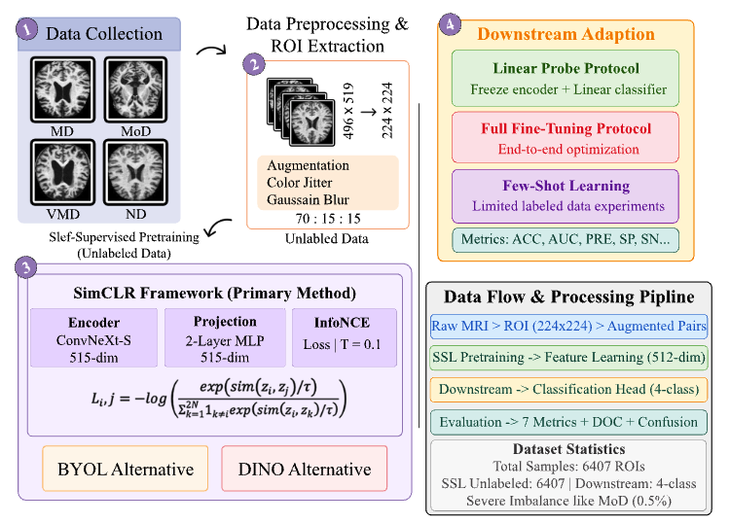
5th International Conference on Applied Intelligence and Informatics (AII 2025)
Methodology: Pipeline
Our workflow consists of four main stages, designed to learn from unlabeled data and adapt for classification.
The dataset comprises 6,407 images
Figure 1: Illustrating the complete workflow.
Paper ID- 2025051097
10
Notes:
Dataset:
A total of 6,407 Region-of-Interest (ROI) extractions from MRI brain scans.
Four Diagnostic Classes:
Mild Dementia (MD)
Moderate Dementia (MoD)
Normal Dementia (ND)
Vascular Mild Dementia (VMD)
Severe Class Imbalance: The MoD class represents only 0.5% of the total samples.
Pre-processing:
Class Weighting: Calculated weights to address the class imbalance during training.
Medical-Specific Augmentations: Applied conservative transformations (flipping, rotation, color jitter) to create augmented views for contrastive learning without losing diagnostic information.
7. Methodology: SSL Framework & Downstream Tasks
Self-Supervised Pre-training (SimCLR):
Goal: To learn robust feature representations from unlabeled MRI data.
Architecture: Used a ConvNeXt-S encoder and a 2-layer MLP projection head.
Contrastive Learning: The model learns by maximizing agreement between two augmented views of the same image (positive pairs) while minimizing agreement with all other images (negative pairs) using the InfoNCE loss function.
Downstream Task Adaptation:
Linear Probing: Froze the pre-trained encoder and trained only a linear classifier on top to test the quality of SSL features.
Full Fine-Tuning: Unfroze the entire network and trained it end-to-end on the labeled data for maximum performance.
Few-Shot Learning: Fine-tuned the model using only small fractions (1%, 5%, 10%) of the labeled data to simulate real-world data scarcity.

Slide 11
5th International Conference on Applied Intelligence and Informatics (AII 2025)
Result
SSL Performance Analysis
Table 1: SSL Methods Comparison (Classification Task)
SSL Method | Backbone | Protocol | Labeled (%) | ACC | AUC | PRE | SP | SN | F1 | MCC
SimCLR | ConvNeXt-S | Linear Probe | 100 | 97.35 | 98.92 | 97.12 | 98.48 | 96.98 | 97.05 | 95.82
SimCLR | ConvNeXt-S | Full Fine-Tune | 100 | 98.21 | 99.15 | 98.05 | 99.05 | 97.88 | 97.96 | 96.88
BYOL | ResNet-50 | Linear Probe | 100 | 96.42 | 98.35 | 96.15 | 97.95 | 95.85 | 95.98 | 94.25
BYOL | ResNet-50 | Full Fine-Tune | 100 | 97.05 | 98.72 | 96.88 | 98.35 | 96.42 | 96.65 | 95.48
DINO | ViT-B/16 | Linear Probe | 100 | 96.85 | 98.58 | 96.42 | 98.15 | 96.12 | 96.28 | 95.05
DINO | ViT-B/16 | Full Fine-Tune | 100 | 97.45 | 98.85 | 97.18 | 98.62 | 96.95 | 97.05 | 95.92
SimCLR with ConvNeXt-S was the top performer.
Full Fine-Tuning consistently outperformed Linear Probing, showing the benefit of adapting the learned features to the specific task.
Paper ID- 2025051097
11

Slide 12
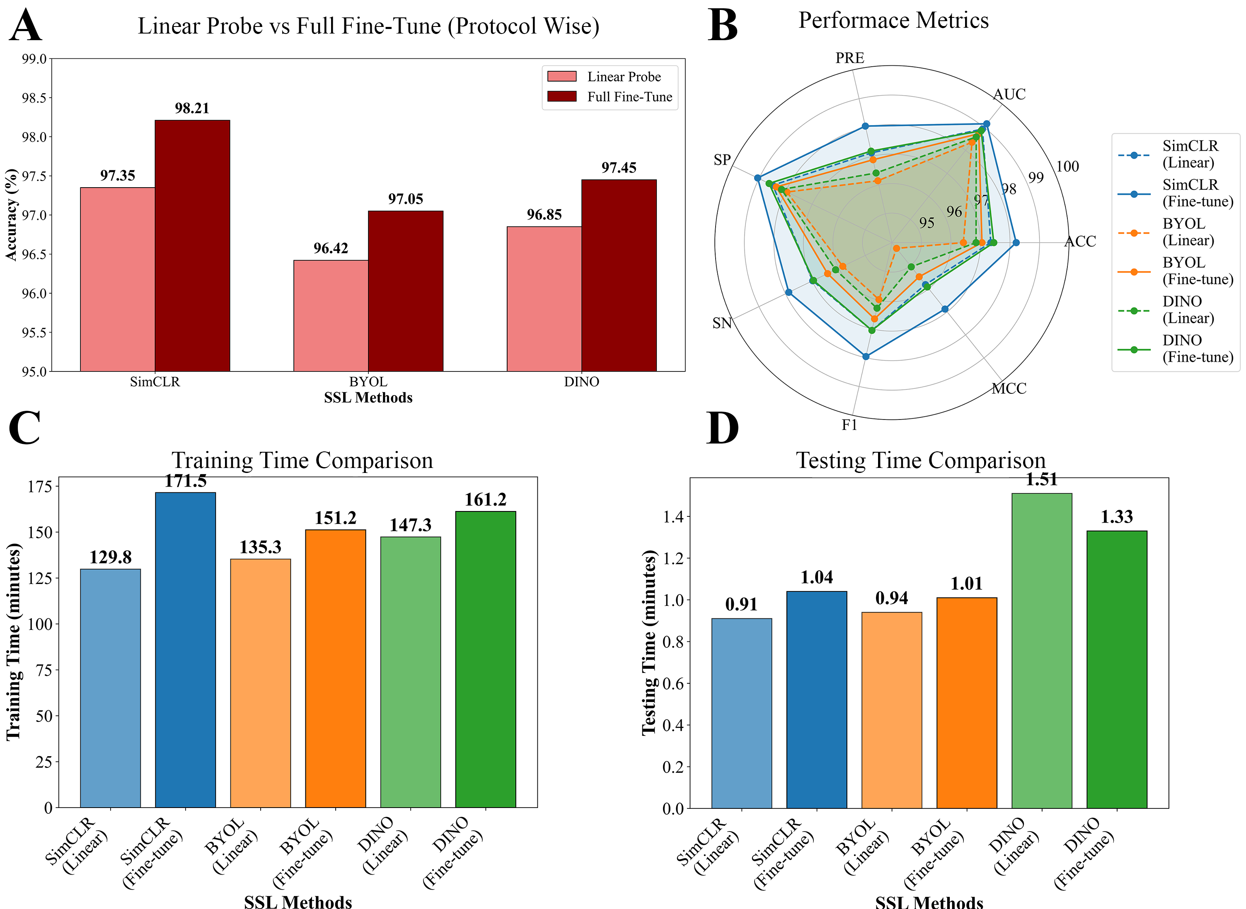
5th International Conference on Applied Intelligence and Informatics (AII 2025)
Result Cont.
Performance Comparison
Performance analysis of SSL methods for Alzheimer’s disease classification. (A) Protocol comparison showing SimCLR achieving 98.21% accuracy with full fine-tuning. (B) Multi-metric evaluation across all SSL approaches. (C) Training time efficiency analysis. (D) Testing time comparison for clinical deployment feasibility.
Figure 2: Performance analysis of SSL methods for Alzheimer’s disease classification.
Paper ID- 2025051097
12

Slide 13
5th International Conference on Applied Intelligence and Informatics (AII 2025)
Result
Few-Shot Learning & Label Efficiency
The SSL framework demonstrated remarkable label efficiency, maintaining high performance with only a fraction of labeled data.
Table 2: Few-Shot Learning Performance
SSL Method | Backbone | Protocol | Labeled (%) | ACC | AUC | F1 | MCC
SimCLR | ConvNeXt-S | Full FT | 10 | 95.25 | 97.85 | 95.05 | 93.45
SimCLR | ConvNeXt-S | Full FT | 5 | 93.48 | 96.25 | 93.12 | 91.28
SimCLR | ConvNeXt-S | Full FT | 1 | 89.42 | 94.12 | 89.05 | 86.35
BYOL | ResNet-50 | Full FT | 10 | 94.15 | 97.12 | 93.85 | 92.05
BYOL | ResNet-50 | Full FT | 5 | 91.85 | 95.28 | 91.45 | 89.25
BYOL | ResNet-50 | Full FT | 1 | 87.35 | 92.18 | 87.05 | 83.88
DINO | ViT-B/16 | Full FT | 10 | 93.95 | 96.85 | 93.62 | 91.85
DINO | ViT-B/16 | Full FT | 5 | 91.25 | 95.48 | 91.05 | 89.05
DINO | ViT-B/16 | Full FT | 1 | 88.15 | 93.25 | 87.88 | 84.45
Paper ID- 2025051097
13

Slide 14
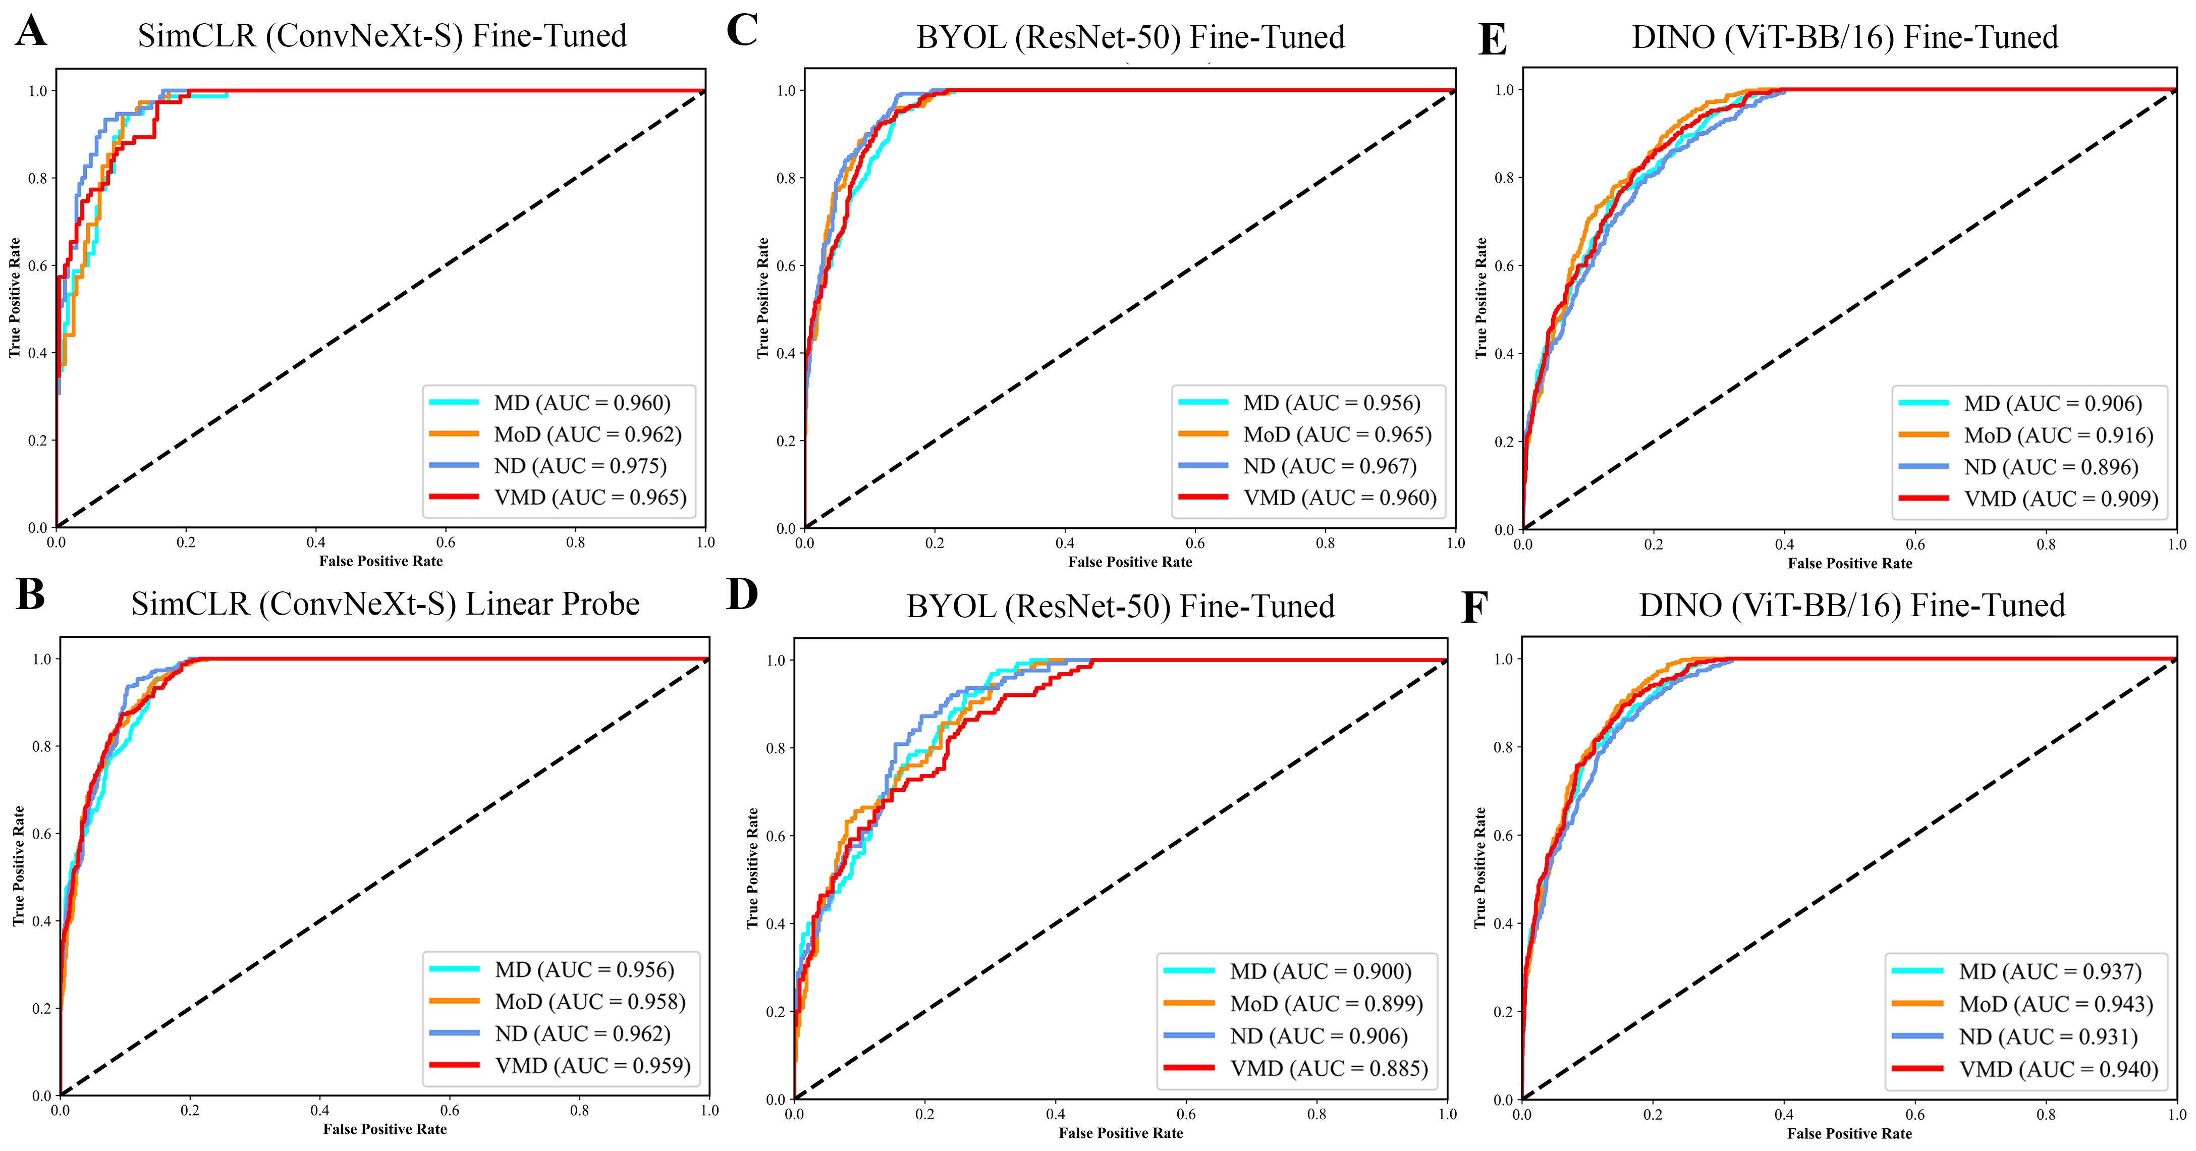
5th International Conference on Applied Intelligence and Informatics (AII 2025)
Result Cont.
Per-Class Performance
ROC curves demonstrate high discriminative power for all SSL methods.
SimCLR (Fine-Tuned) shows the highest Area Under the Curve (AUC) values across all four diagnostic classes, indicating superior and balanced performance.
Figure 3: ROC curves for the four classes (MD, MoD, ND, VMD) using SimCLR (ConvNeXt-S), BYOL (ResNet-50), and DINO (ViT-B/16) under fine-tuned and linear probe settings, with corresponding AUC values shown in the legend demonstrate SimCLR performing better than others.
Paper ID- 2025051097
14

Slide 15
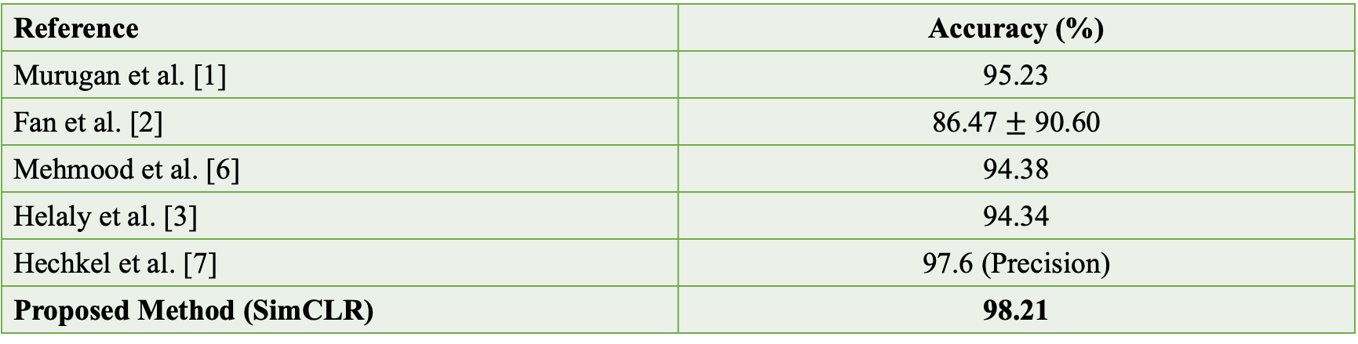
5th International Conference on Applied Intelligence and Informatics (AII 2025)
Result Cont.
State-of-the-Art Comparison
Our proposed model sets a new benchmark for accuracy on this task.
Table 3: Comparison of the Proposed Model with the State-of-the-Art Models
Reference | Accuracy (%)
Murugan et al. [1] | 95.23
Fan et al. [2] | 86.47 $±$ 90.60
Mehmood et al. [6] | 94.38
Helaly et al. [3] | 94.34
Hechkel et al. [7] | 97.6 (Precision)
Proposed Method (SimCLR) | 98.21
Paper ID- 2025051097
15

Slide 16
5th International Conference on Applied Intelligence and Informatics (AII 2025)
Conclusion
This study successfully demonstrates that a contrastive self-supervised learning framework can significantly advance the automated diagnosis of Alzheimer’s disease from MRI images.
The SimCLR model with a ConvNeXt-S backbone established a new state-of-the-art performance, proving its effectiveness.
The framework’s high performance in few-shot learning scenarios highlights its capability to overcome the critical challenge of data scarcity in medical imaging.
This approach has strong potential for real-world clinical deployment, offering a path to create accurate, data-efficient AI tools to assist clinicians and reduce diagnostic workload.
Paper ID- 2025051097
16

Slide 17
5th International Conference on Applied Intelligence and Informatics (AII 2025)
Future Work
Enhance Generalizability: Validate the model on large, multi-institutional datasets to ensure robustness across different scanners and patient populations.
Integrate Multi-Modal Data: Incorporate other imaging modalities like PET and functional MRI to provide a more comprehensive diagnostic view.
Explore Advanced Architectures: Investigate Vision Transformer (ViT) backbones, which are showing increasing promise in computer vision.
Enable Collaborative Training: Develop federated learning protocols to train models across multiple institutions without compromising patient privacy.
Paper ID- 2025051097
17

Slide 18
5th International Conference on Applied Intelligence and Informatics (AII 2025)
References
[1] Suriya Murugan, Chandran Venkatesan, MG Sumithra, Xiao-Zhi Gao, B Elakkiya, Muthuramalingam Akila, and S Manoharan. Demnet: a deep learning model for early diagnosis of alzheimer diseases and dementia from mr images. Ieee Access, 9:90319–90329, 2021.
[2] Zhonghao Fan, Johann Li, Liang Zhang, Guangming Zhu, Ping Li, Xiaoyuan Lu, Peiyi Shen, Syed Afaq Ali Shah, Mohammed Bennamoun, Tao Hua, et al. U-net based analysis of mri for alzheimer’s disease diagnosis. Neural Computing and Applications, 33(20):13587–13599, 2021
[3] Hadeer A Helaly, Mahmoud Badawy, and Amira Y Haikal. Toward deep mri segmentation for alzheimer’s disease detection. Neural Computing and Applications, 34(2):1047–1063, 2022
[4] Min Gu Kwak, Yi Su, Kewei Chen, David Weidman, Teresa Wu, Fleming Lure, Jing Li, and Alzheimer’s Disease Neuroimaging Initiative. Self-supervised contrastive learning to predict the progression of alzheimer’s disease with 3d amyloid-pet. Bioengineering, 10(10):1141, 2023
[5] Peiyuan Li, Zhuxin Peng, Qianyi Zhan, Zhenping Xie, and Yuan Liu. A contrastive learning framework for alzheimer’s disease classification (clfad). In International Conference on Intelligent Computing, pages 159–171. Springer, 2025.
[6] Muhammad Hamza Mehmood, Farman Hassan, Auliya Ur Rahman, Abdul Rauf, and Muhammad Azaz Farooq. Alzr-net: a novel approach to detect Alzheimer disease. In 2023 International Conference on Communication, Computing and Digital Systems (C-CODE), pages 1–6. IEEE, 2023.
[7] Wided Hechkel, Rim Missaoui, and Abdelhamid Helali. Early diagnosis of alzheimer’s disease using yolov11 deep learning model in mri scans. In 2025 IEEE 22nd International Multi-Conference on Systems, Signals & Devices (SSD), pages 599–604. IEEE, 2025.
Paper ID- 2025051097
18

Slide 19
5th International Conference on Applied Intelligence and Informatics (AII 2025)
Thank you everyone for your kind attention.
Welcome to Q & A session!!!
Paper ID- 2025051097
19

